Slide 1
Pharmacy Council of India
K Rajasekhar,
Dy Director General ,
State Informatics Officer
and Head Centre for Data Governance
NIC, MeitY, Govt of India.

Slide 2
Content
Number of Institutes Registered
Number of SIFs submitted.
Number of Institutes Paid fee successfully
Number of SIFs scrutinized digitally.
Number of SIFs verified digitally.
Number of Inspectors Onboarded.
Number of New Inspectors Onboarded
Number of Inspections allocated automatically
Number of Inspection Reports submitted digitally.
The PCI Office Notes Prepared Successfully -
Facility for entering the Decisions of EC Members
The Approved Certificates Generated Successfully.
Number of Issues Resolved through Help Desk.
Number of Students onboarded through the Students Module
Number of Pharmacists Onboarded Online .
Number of Pharmacists registrations Approved online by State Pharmacy Council Registrar
Number of Faculty Onboarded Successfully.

Slide 3
DIGI-PHARMed
Introduced in 2019-20, developed by NIC, Hyd
Digital Transformation
Aim - To support and provide value to- PCI, Institutions, Faculty, Students, and the Profession
Scalable, Flexible, Efficient, Proactive and Accurate

Slide 4
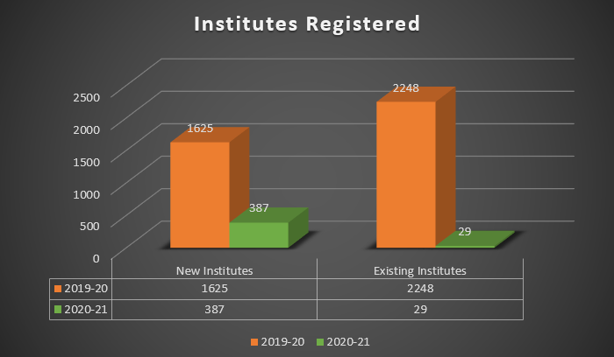
Number of Institutes Registered -- 4289 2019-20: 1625 (New), 2248 (Existing) 2020-21: 387 (New), 29 (Existing)

Slide 5
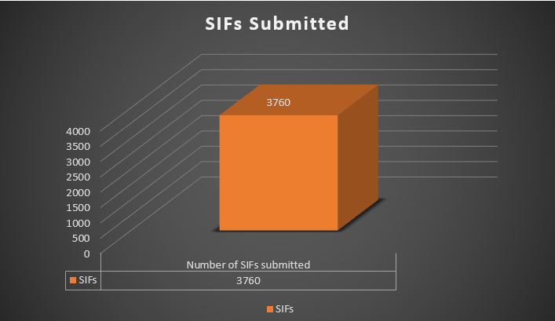
Number of SIFs submitted. -- 3760

Slide 6
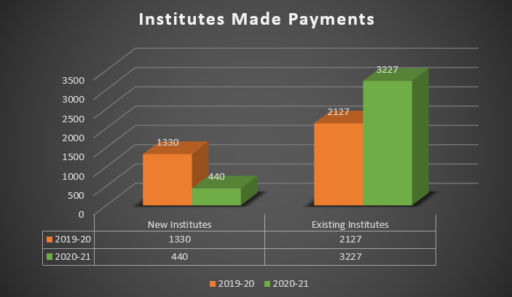
Number of Institutes Paid fee successfully -- 3667 2019-20: 1330 (New), 2127 (Existing) 2020-21: 440 (New), 3227 (Existing)

Slide 7
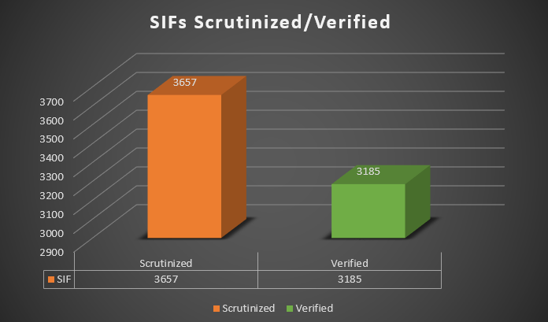
Number of SIFs scrutinized digitally. -- 3657 Number of SIFs verified digitally. -- 3185

Slide 8
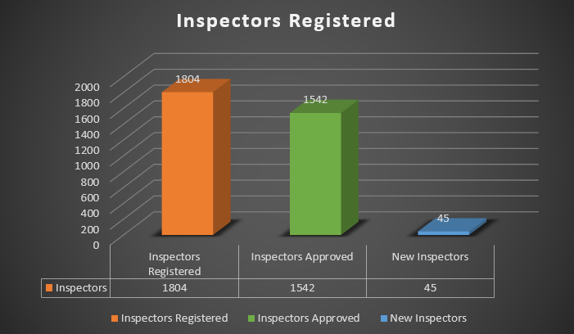
Number of Inspectors Onboarded. -- 1804, Approved - 1542 Number of New Inspectors Onboarded -- 45

Slide 9
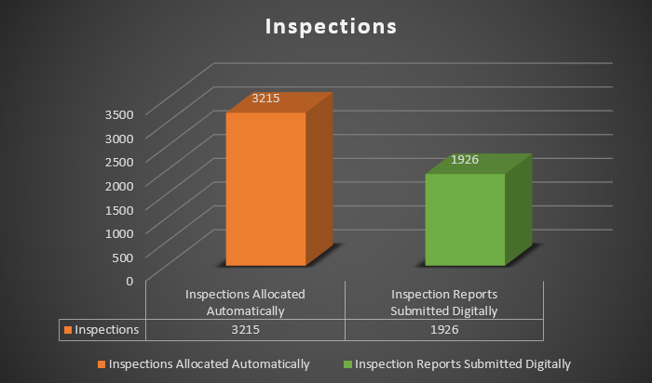
Number of Inspections allocated automatically -- 3215 Number of Inspection Reports submitted digitally -- 1926

Slide 10
PCI Office Notes Prepared Successfully -- 2111

Slide 11
Facility for entering the Decisions of EC Members -- 0

Slide 12
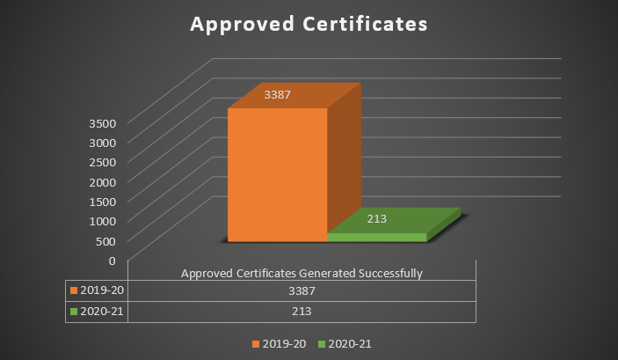
The Approved Certificates Generated Successfully. 2019-20: 3387 2020-21: 213

Slide 13
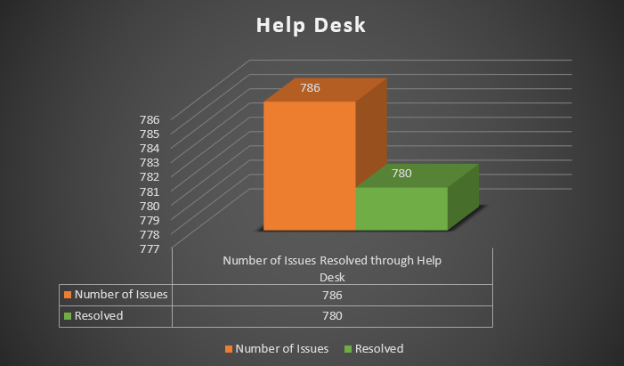
Number of Issues Resolved through Help Desk -- (780/786)

Slide 14
Number of Students onboarded through the Students Module -- 9693

Slide 15
Number of Pharmacists Onboarded Online -- 5583 Number of Pharmacists registrations Approved online by State Pharmacy Council Registrar -- 0

Slide 16
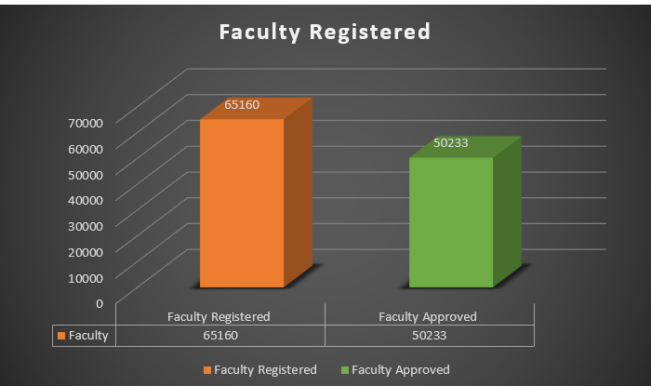
Number of Faculty Onboarded Successfully. -- 65160 Approved - 50233

Slide 17
sekkhar@nic.in

